Slide 1


Charting Assignment 3.2
Shaquiel Pashtunyar
DSC640

Slide 2
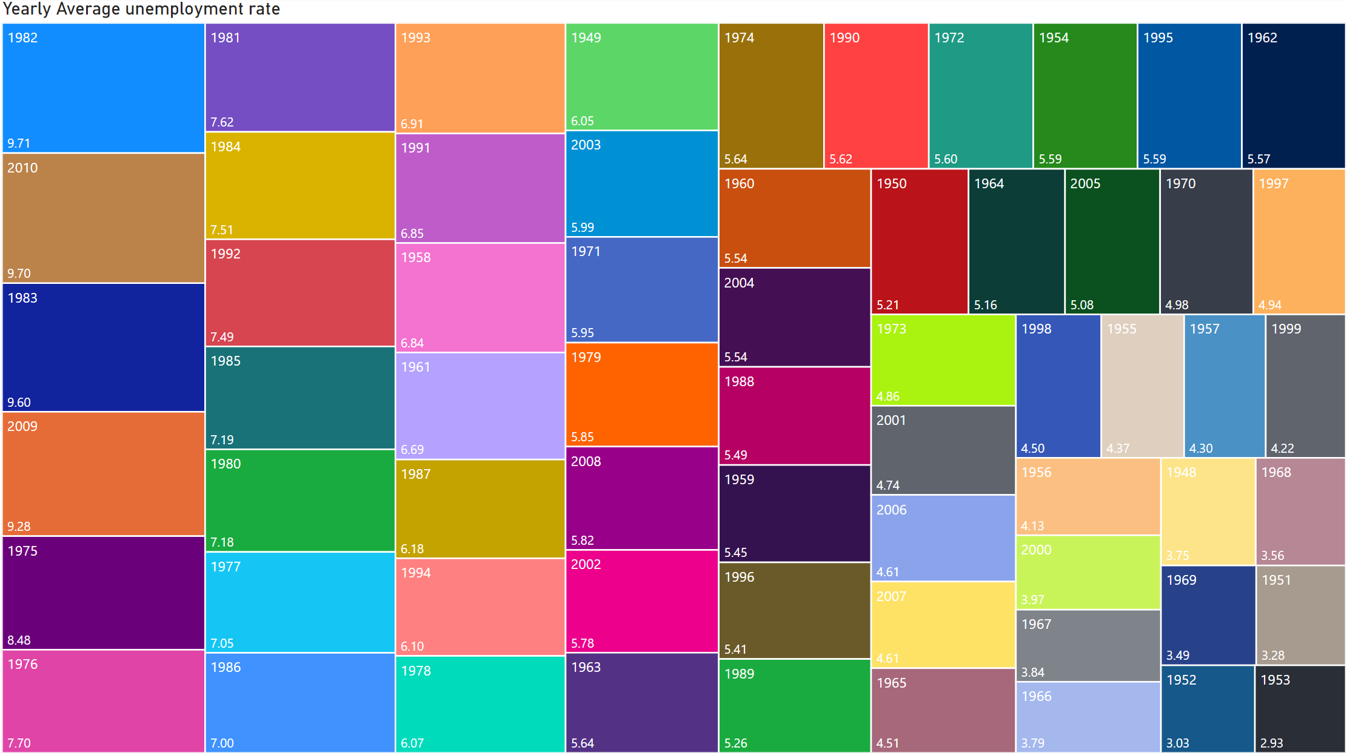
PowerBI Tree Map

Slide 3
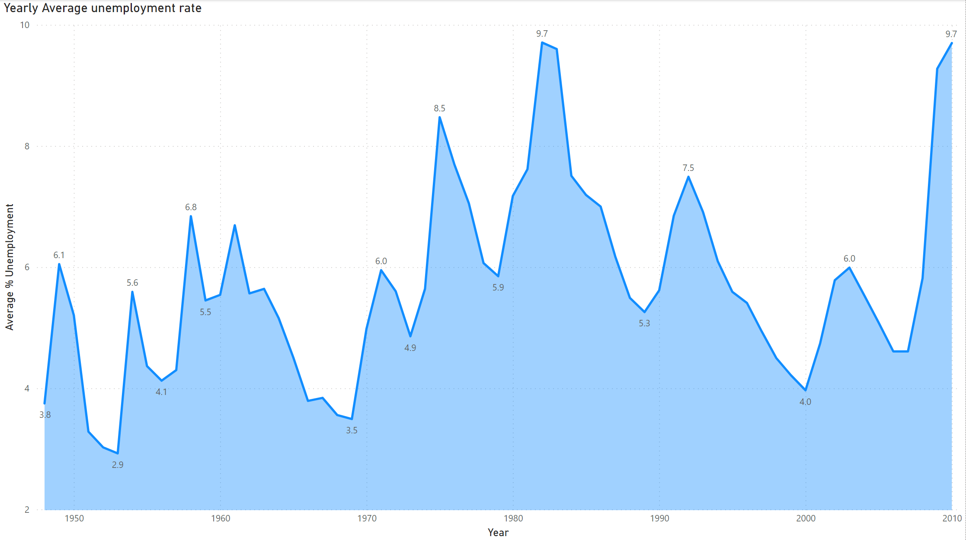
PowerBI Area Chart

Slide 4
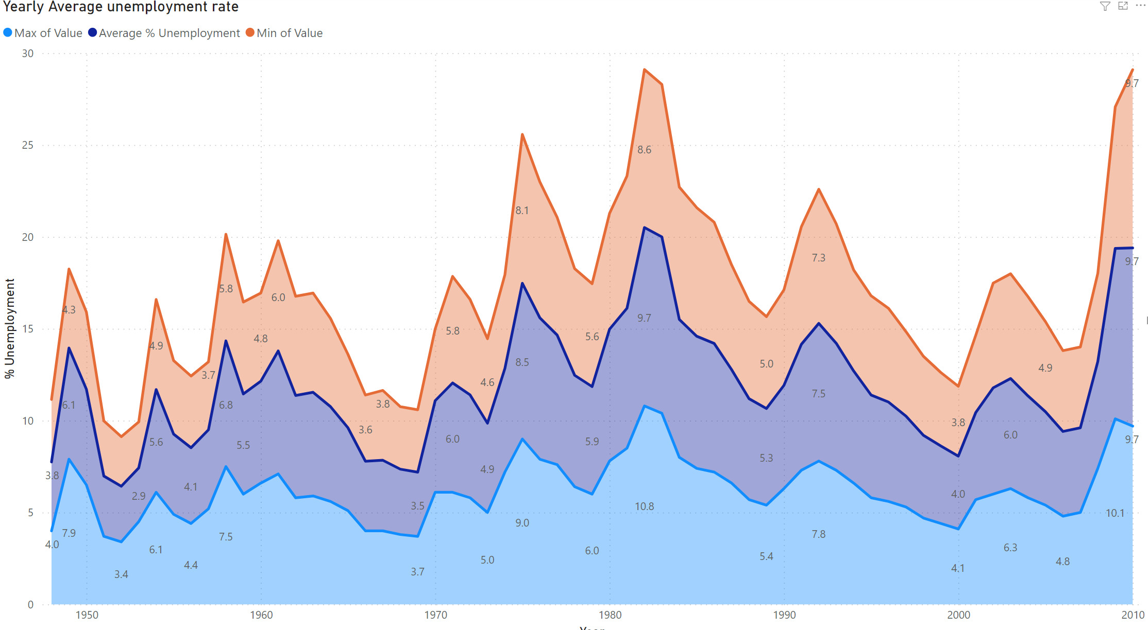
PowerBI Stacked Area Chart

Slide 5
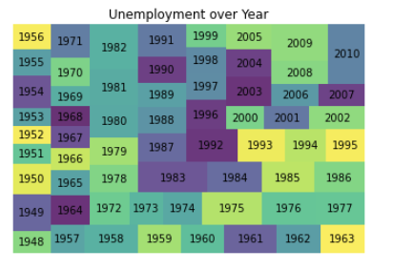
Python Tree Map
(Code In ipynb file)
squarify.plot(sizes=d, label=a, alpha=.8)
plt.title('Unemployment over Year')
plt.axis('off')
plt.show()

Slide 6
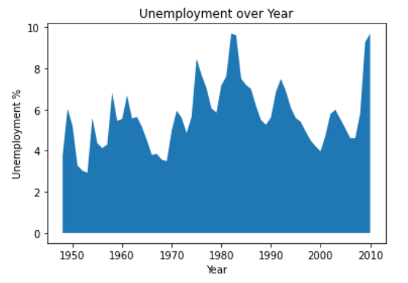
Python Area Chart
# Area plot
plt.fill_between(a, d)
plt.title('Unemployment over Year')
plt.xlabel('Year')
plt.ylabel('Unemployment %')
plt.show()

Slide 7
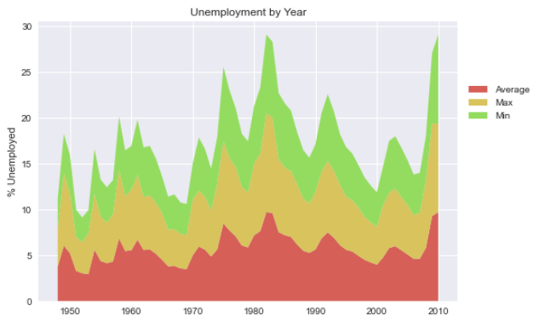
Python stacked area chart
colors = sns.color_palette("hls", 8)
labels=["Average", "Max", "Min"]
plt.stackplot(a, d, m1, m2, labels=labels, colors=colors)
plt.legend(loc = "upper center",
bbox_to_anchor=(1.1, 0.8), ncol=1)
plt.title('Unemployment by Year')
plt.ylabel('% Unemployed')
plt.show()

Slide 8
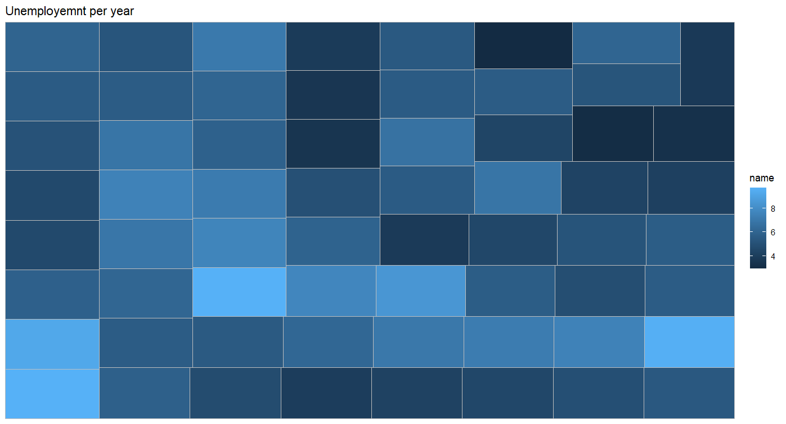
R Tree map
new_df <-unemploy_DF %>% group_by(Year) %>% summarise_at(vars(Value), list(name = mean))
ggplot(new_df, aes(area = Year, fill = name)) + geom_treemap()+ ggtitle("Unemployemnt per year")

Slide 9
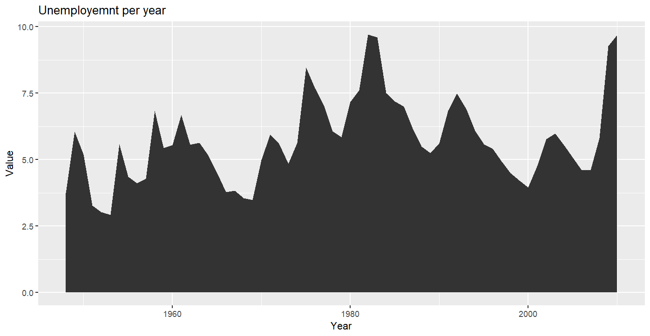
R Area Chart
ggplot(unemploy_DF, aes(x=Year, y=Value)) +stat_summary(fun = "mean", geom = "area") + ggtitle("Unemployemnt per year")

Slide 10
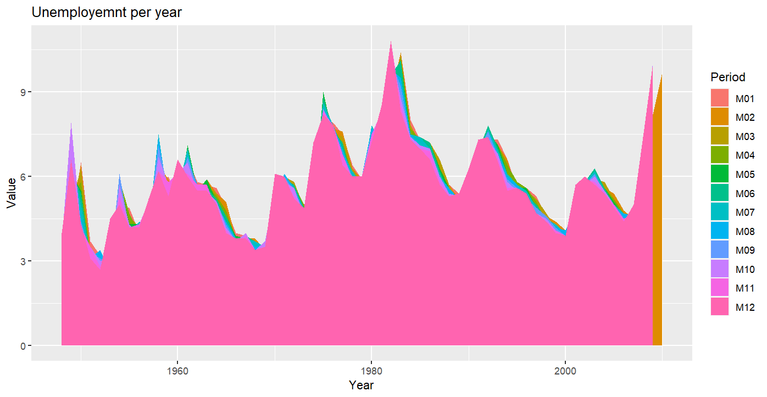
R Stacked Area Chart
ggplot(unemploy_DF, aes(x=Year, y=Value, fill = Period)) +stat_summary(fun = "mean", geom = "area") + ggtitle("Unemployemnt per year")

